Slide 1

Attack, defense & analysis of the raven network
By Freda Vuong

Slide 2

Presentation of final engagement
5 min Presentation

Slide 3

Overview of presentation
Network topology, description of target, explanation of the pen-test.
Key vulnerabilities found
Recommendations

Slide 4
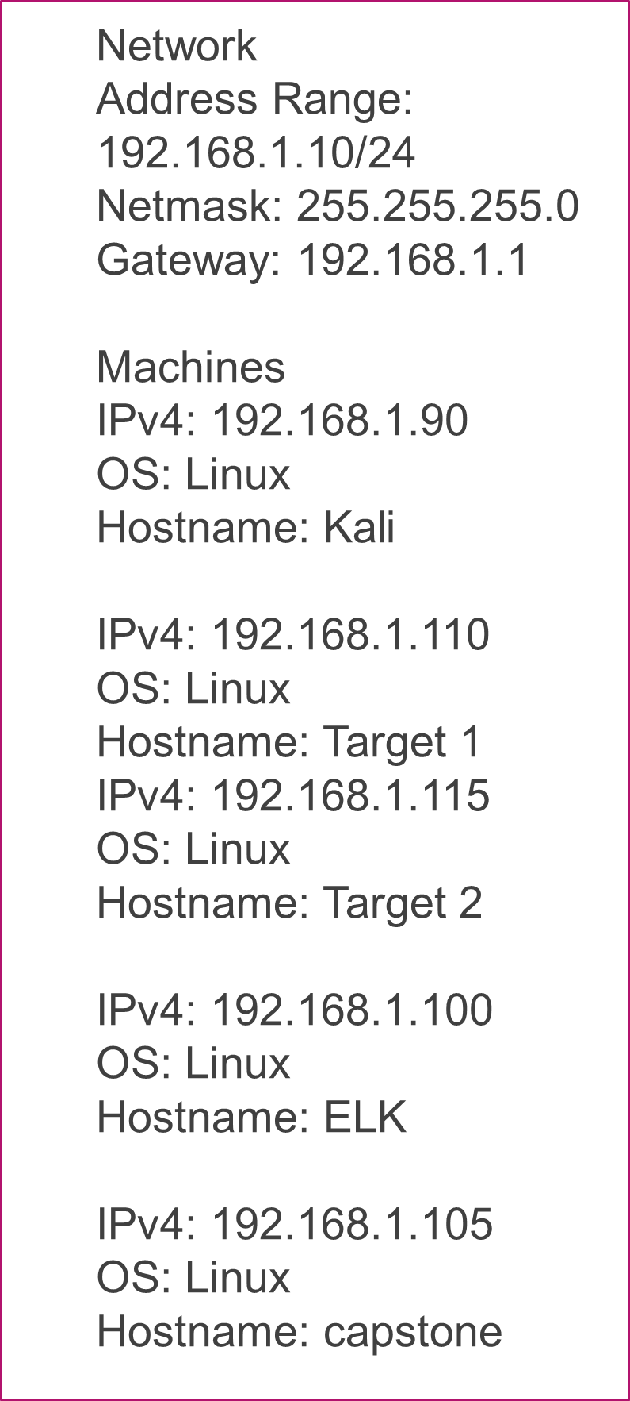
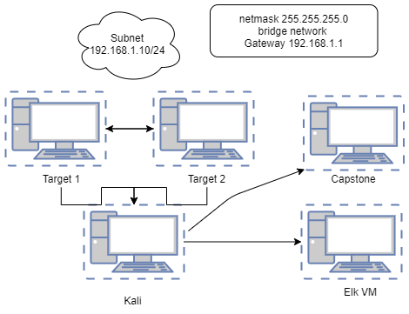
Network topology

Slide 5
Target 1 vulnerabilities:
VULNERABILITY | DESCRIPTION | IMPACT
DIRECTORY LISTING (CWE-548) | Able to use the browser to read the full contents of directories | Access to page source information, ability to view sensitive details about the company
WEAK PASSWORDS (CWE 307) | Weak password, no hashes or special characters used. | Able to guess Michaels’ password to login to shell
OPEN SSH / APACHE SERVICE OUTDATED (2.4.10) | This version of openSSH (6.7) is vulnerable to remote attackers exposing users, and allows attackers to gain access and allows dos attacks. | Able to gain a shell into Michael and Steven’s logins and eventually gain root access.
WORDPRESS (OUT-DATED VERSION 4.8.1.5) | WordPress is a popular way to build a website, however if it is not patched it can be highly vulnerable to attackers. | Wordpress is highly vulnerable, I was able to get the login to root and the password by viewing the php file within the WordPress directory.

Slide 6
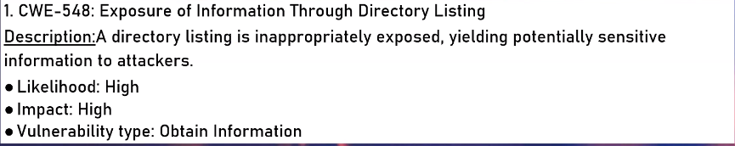
Directory listing

Slide 7
Directory listing
Directory listing is a web server function that displays the directory contents when there is no index file in a specific website directory.
It is dangerous to leave this function turned on for the web server because it leads to information disclosure.
For example, in Target 1, the index file did not exist and because directory listing was turned on, we were able to see the contents of the directory.

Slide 8
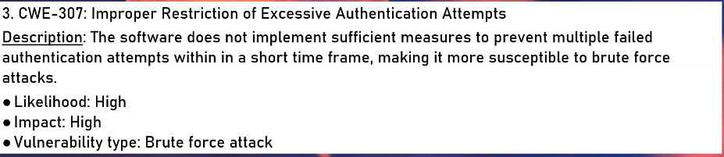
Weak passwords, brute forceable (VULNERABILITY 2)
It was discovered that Target 1 user Michael had an extremely weak password, his own name!

Slide 9
WORDPRESS: POTENTIAL WEAKNESS

Slide 10
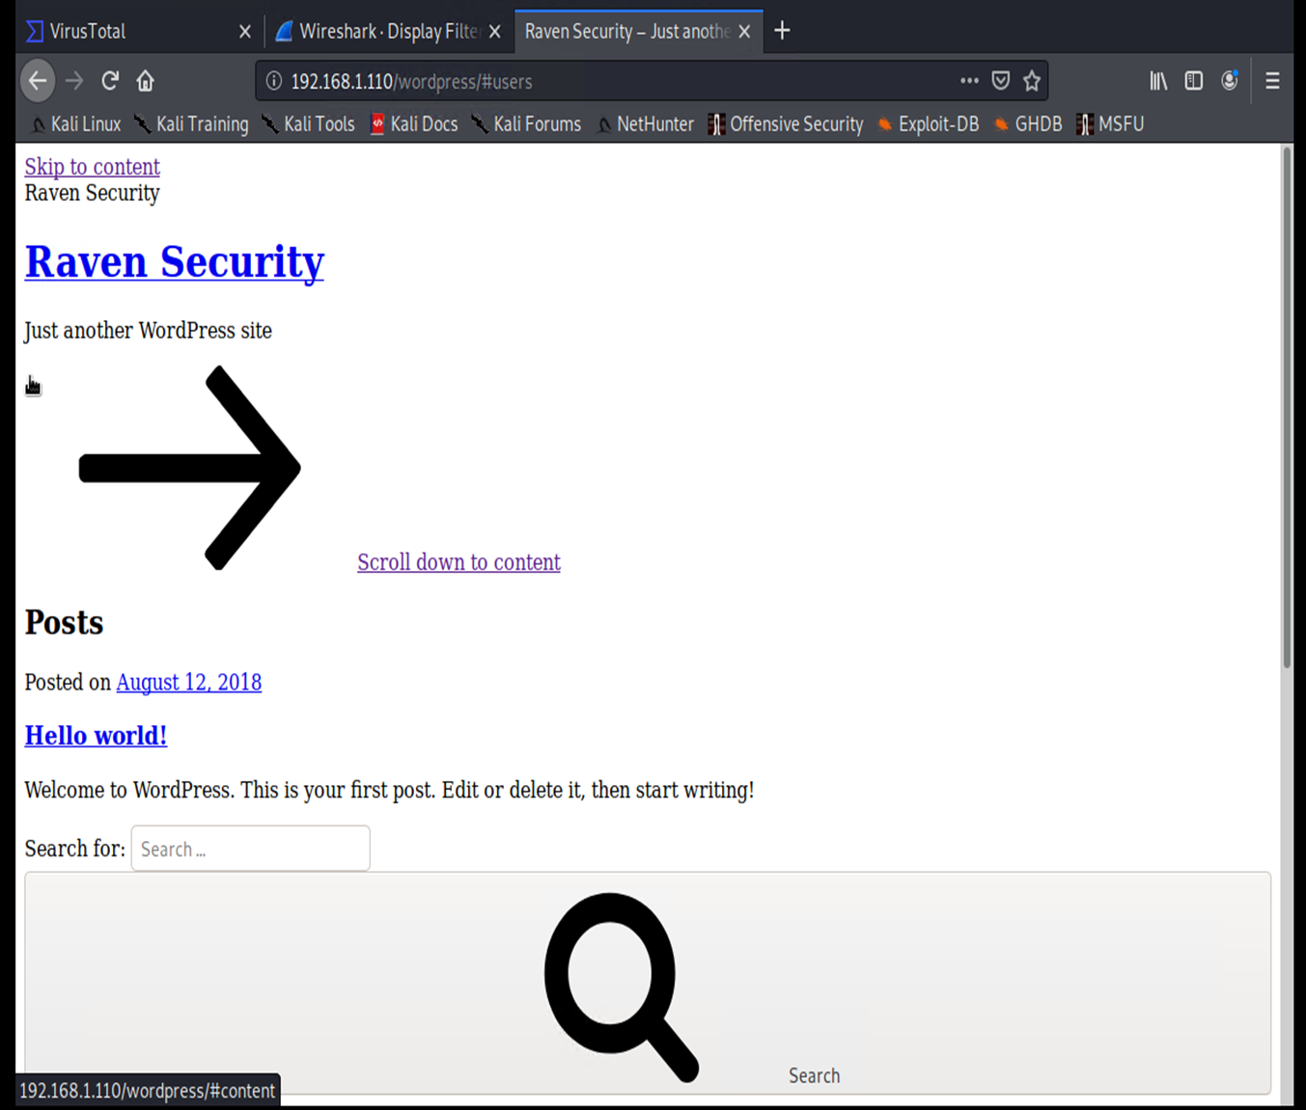
WORDPRESS ENUMERATION ON TARGET 1.
The imagine to the right shows how wordpress site was enumerated after just entering the IP address followed by /wordpress.

Slide 11
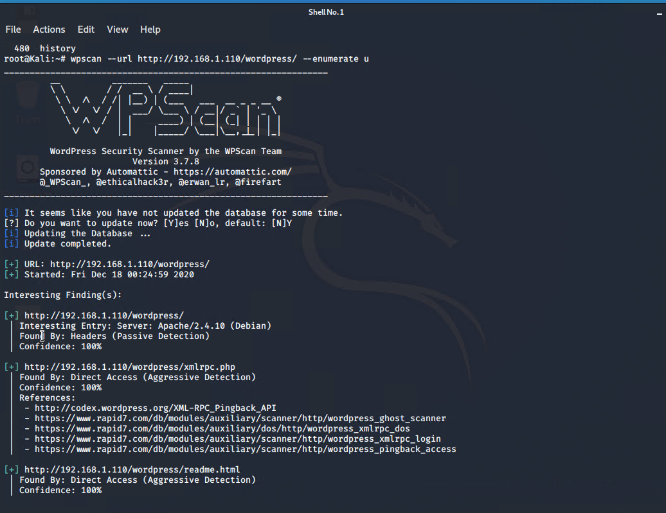
WP SCAN – WordPress vulnerabilities

Slide 12
WORDPRESS EXPLAINED..
WordPress is the most popular way to build a website, but this also makes it a common target for attackers all around the world.
Every year, hundreds of thousands of WordPress sites get hacked, as well as ecommerce sites
Out-of-date Core Software,
Out-of-date Plugins or Themes
Compromised Login Credentials for WordPress, FTP or Hosting
Poor host environment and out of date technology can also be a cause for poor security around WordPress.

Slide 13
Word press continued..
WordPress Version (Image source: WordPress.org)
The image to the right shows that only 62% of WordPress sites were running on the latest version in 2017.

Slide 14

It’s easy to pass the responsibility to web hosts, but there is a tremendous amount of security that lies on the website owner aswell.
The same can be said about managing your own website!!

Slide 15
Hardening Techniques for WordPress
Limited access to users, making sure to reduce possible entry points available to a malicious character.
Containment
Preparation and knowledge
Backup plan and recover installation in case of catastrophe
Only get plugins from trusted sources

Slide 16

Open ssh vulnerability
Open SSH or secure shell is the popular protocol for doing system administration on Linux systems.
As this service opens up a potential gateway into the system, it is one of the steps to hardening a linux system
The client configuration settings can be found in /etc/ssh/ssh_config, it is where the server configuration file is located.

Slide 17
Open ssh hardening tips
Use a strong password.
Change the SSH default port.
Always use protocol version 2.
Disable the root login.
Limit user access.
Use key-based for authentication.

Slide 18

Thank you !
Freda.Vuong@hotmail.com
Please ADD ME ON LINKED IN AND CHECK OUT MY GITHUB URL

